Slide 1

Image courtesy of NASA/GSFC

Slide 2
Global Environmental Change:
Technology and the Future of Planet Earth
Eugene S. Takle
Professor
Department of Agronomy
Department of Geological and Atmospheric Science
Director, Climate Science Program
Iowa State University
Ames, IA 50011
Technology, Globalization, and Culture
ME/WLC 484
Ames Iowa
29 August 2012

Slide 3
Climate change is one of the most important issues facing humanity
The scientific evidence clearly indicates that our climate is changing, and that human activities have been identified as a dominant contributing cause.
Don Wuebbles
Notes:
No disagreement in peer reviewed literature
Powerful statements from every major professional science society and organization in the world
Powerful statements from the National Academies of Sciences (the leadership in science) for every major country
G8 + 5 other countries, May 2009: “The need for urgent action to address climate change is now indisputable.”

Slide 4
Outline
Scientific evidence for global climate change
Changes in Iowa
Impacts of climate change on Iowa agriculture
Alternative projections of climate futures
The need for long-term mitigation that starts now

Slide 5
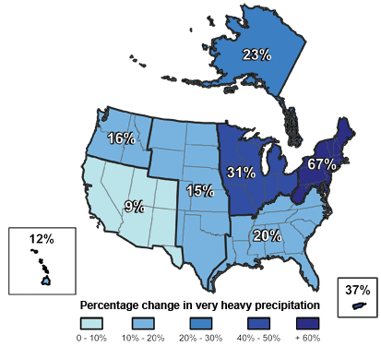
Climate changes are underway in the U.S. and are projected to grow
Temperature rise
Sea-level rise
Increase in heavy downpours
Rapidly retreating glaciers
Thawing permafrost
Lengthening growing
season
Lengthening ice-free season
in the ocean and on lakes
and rivers
Earlier snowmelt
Changes in river flows
Plants blooming earlier; animals, birds and fish moving northward
Don Wuebbles

Slide 6
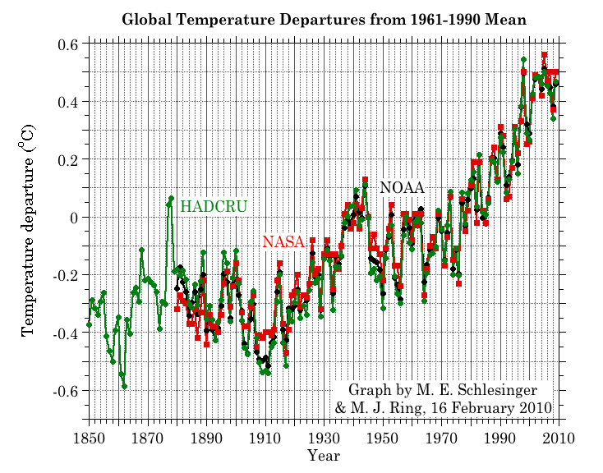
Three separate analyses of the temperature record – Trends are in close agreement
2010 tied 2005 as the warmest year on record since 1880

Slide 7
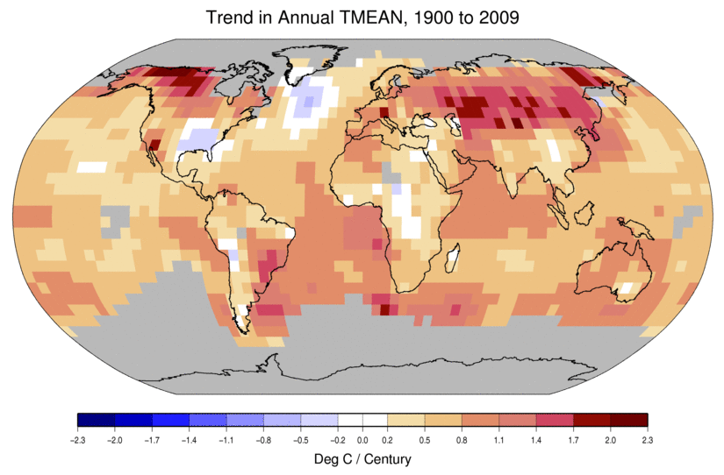
Temperature Changes are Not
Uniform Around the Globe
From Tom Karl, NOAA NCDC

Slide 8
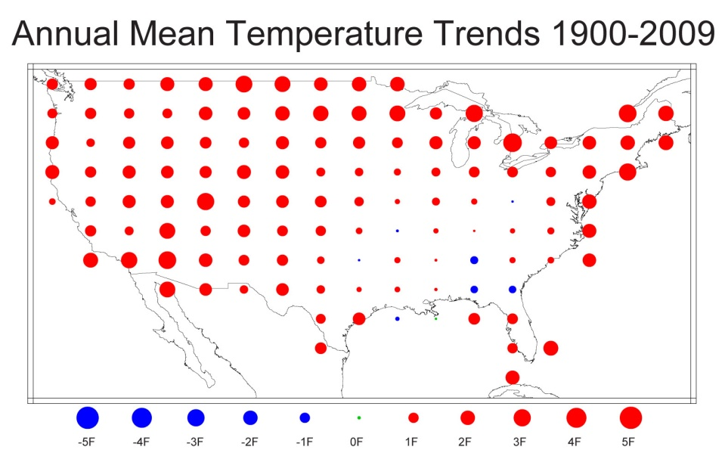
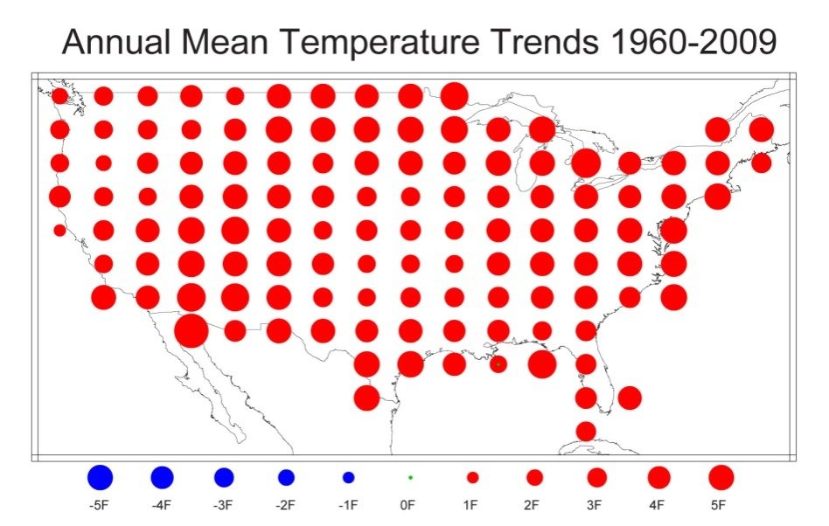
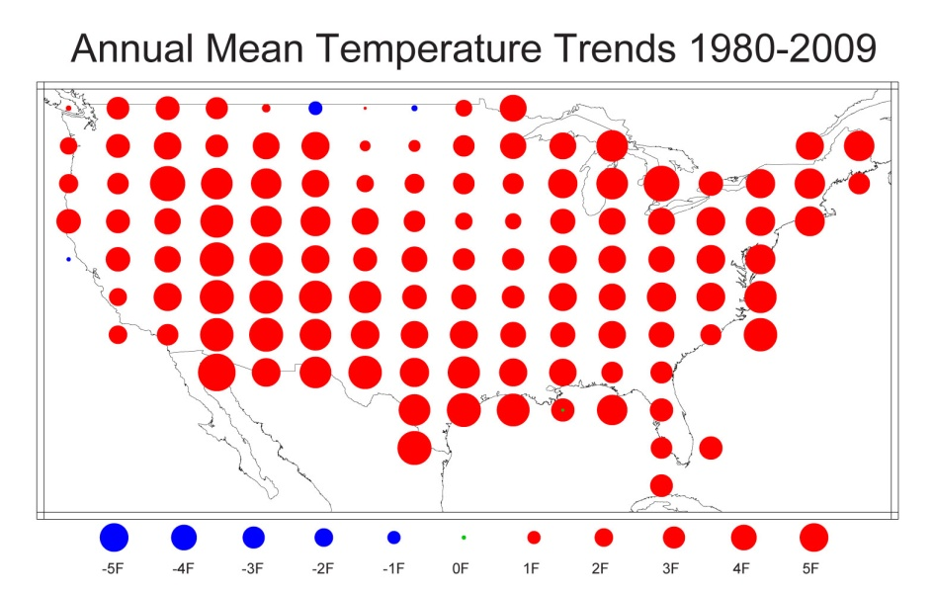
U.S. Temperature Trends
U.S. average temperature has risen more than 2ºF over the past 50 years
From Tom Karl, NOAA NCDC

Slide 9
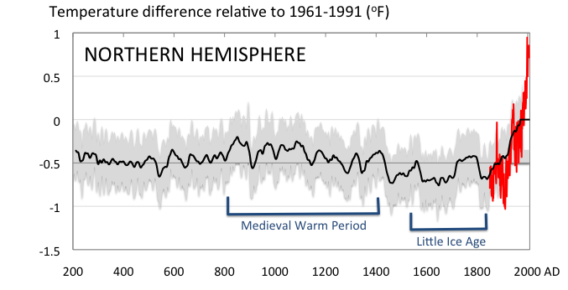
Conditions today are unusual in the context of the last 2,000 years …
Don Wuebbles

Slide 10
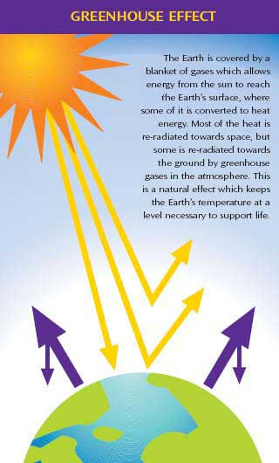
Why does the Earth warm?
1. Natural causes
THE GREENHOUSE EFFECT…
…is 100% natural.
  Heat is trapped in the atmosphere.
…sustains life on Earth.
  Keeps average temperatures at 12.8ºC (55ºF), instead of –29ºC (-20ºF).
Don Wuebbles

Slide 11
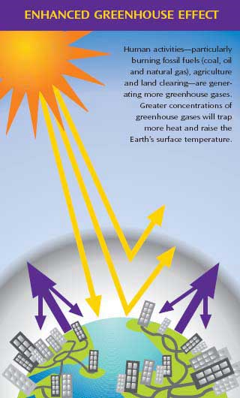
Why does the Earth warm?
2. Human causes
THE ENHANCED GREENHOUSE EFFECT
(or GLOBAL WARMING)
… is primarily human-induced: We’re increasing heat-trapping gases in the atmosphere.
… is like wrapping an extra blanket around the Earth.
Don Wuebbles

Slide 12
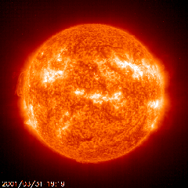
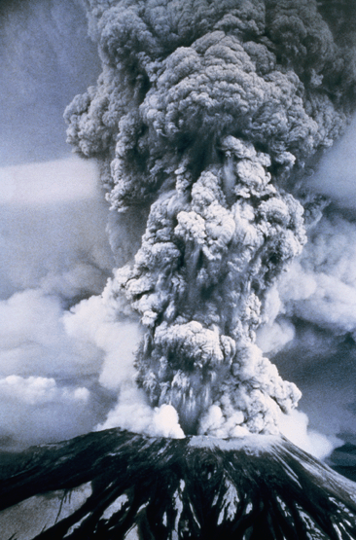
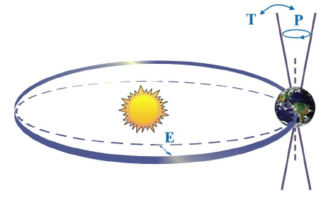

Natural factors affect climate
Variations in the energy
received from the sun
Variations in the Earth's orbit
(Milankovic effect)
Stratospheric
aerosols from
energetic
volcanic eruptions
Chaotic interactions in
the Earth's climate
(for example, El Nino, NAO)
Don Wuebbles

Slide 13
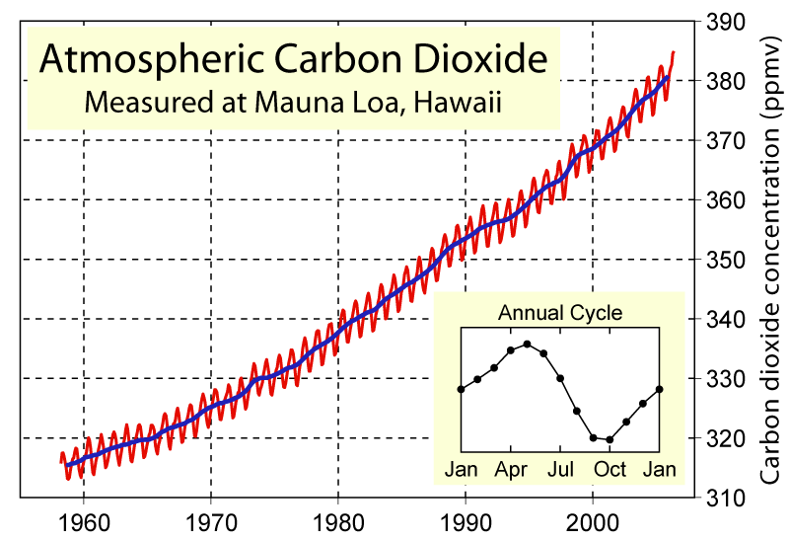
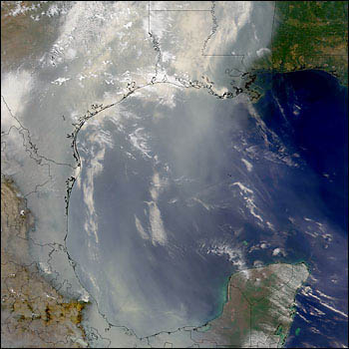
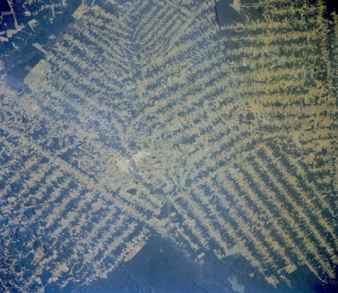
Non-natural mechanisms
Changes in atmospheric concentrations of radiatively important gases
Changes in aerosol particles from burning fossil fuels and biomass
Changes in the reflectivity (albedo) of the Earth’s surface
Don Wuebbles

Slide 14
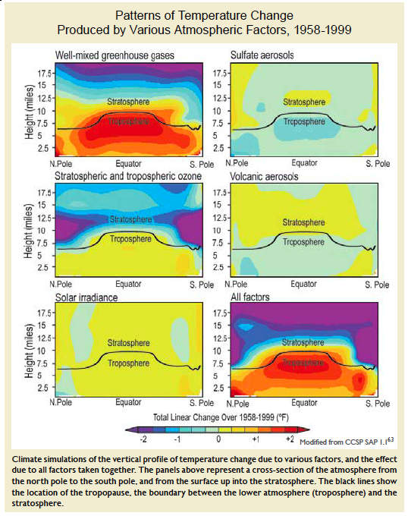
Warming of the Lower and Upper Atmosphere Produced by Natural and Human Causes
Karl, T. R., J. M. Melillo, and T. C. Peterson, (eds.), 2009: Global Climate Change Impacts in the United States. Cambridge University Press, 2009, 196pp.

Slide 15
Warming of the Lower and Upper Atmosphere Produced by Natural and Human Causes
Note that greenhouse gases have a unique temperature signature, with strong warming in the upper troposphere, cooling in the lower stratosphere and strong warming at the surface over the North Pole. No other warming factors have this signature.
Karl, T. R., J. M. Melillo, and T. C. Peterson, (eds.), 2009: Global Climate Change Impacts in the United States. Cambridge University Press, 2009, 196pp.

Slide 16
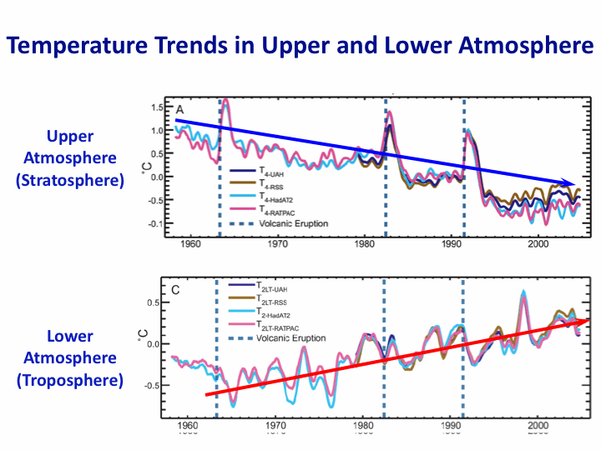
Warming of the Lower and Upper Atmosphere Produced by Natural and Human Causes
Note that greenhouse gases have a unique temperature signature, with strong warming in the upper troposphere, cooling in the lower stratosphere and strong warming at the surface over the North Pole. No other warming factors have this signature.
Karl, T. R., J. M. Melillo, and T. C. Peterson, (eds.), 2009: Global Climate Change Impacts in the United States. Cambridge University Press, 2009, 196pp.

Slide 17
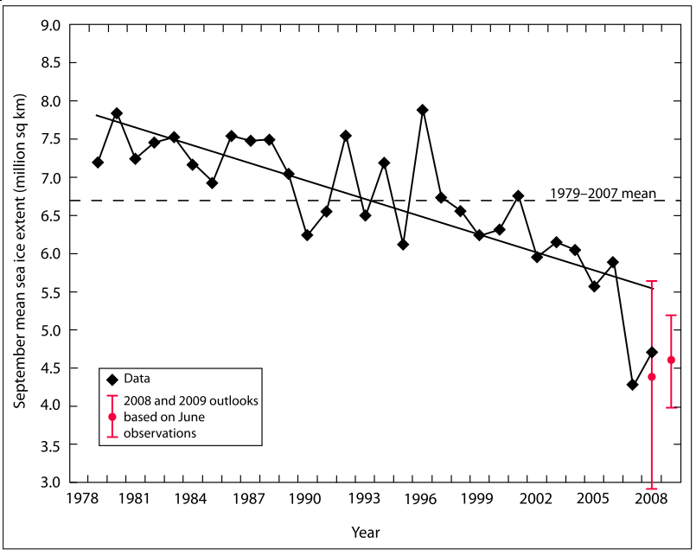
Warming of the Lower and Upper Atmosphere Produced by Natural and Human Causes
Note that greenhouse gases have a unique temperature signature, with strong warming in the upper troposphere, cooling in the lower stratosphere and strong warming at the surface over the North Pole. No other warming factors have this signature.

Slide 18
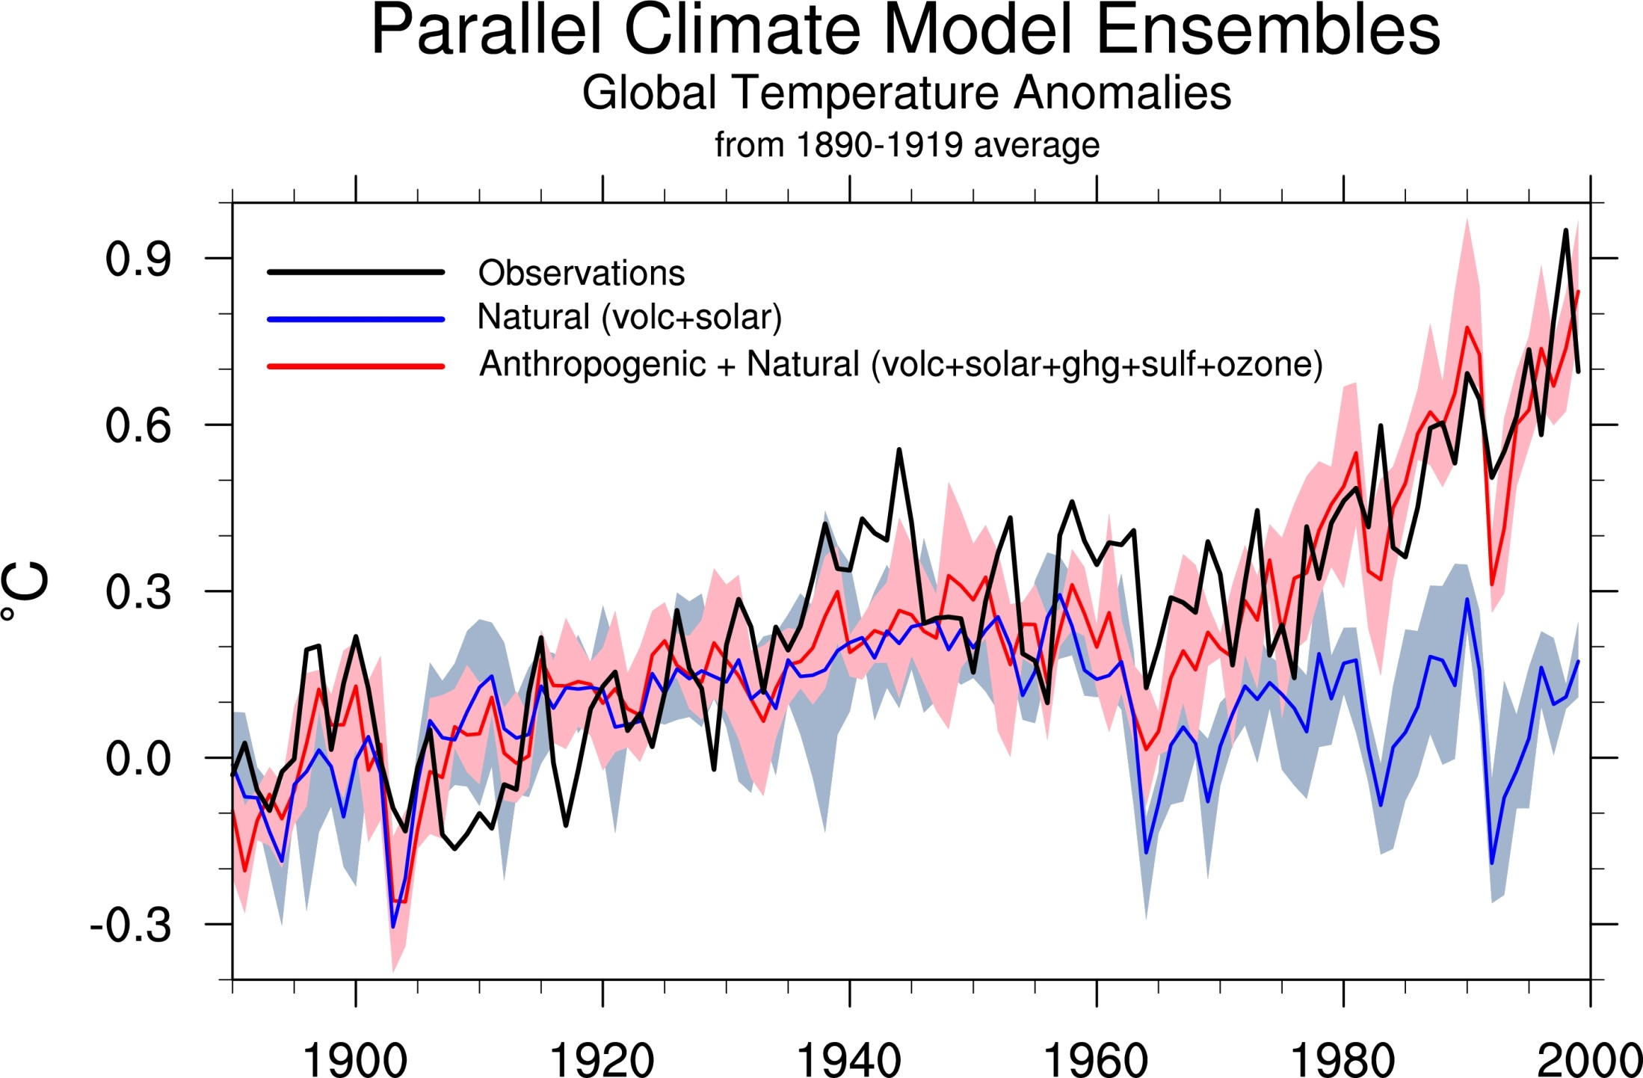
Climate models: Natural processes do not account for
observed 20th century warming after 1965
Don Wuebbles

Slide 19
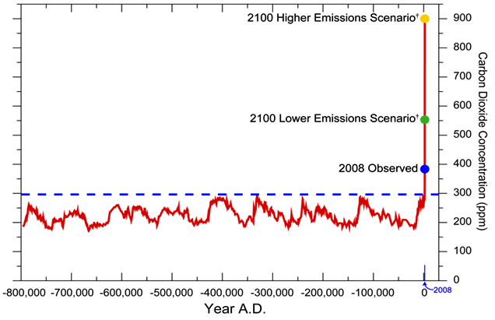
We have Moved Outside the Range of Historical Variation
800,000 Year Record of Carbon Dioxide Concentration
Don Wuebbles

Slide 20
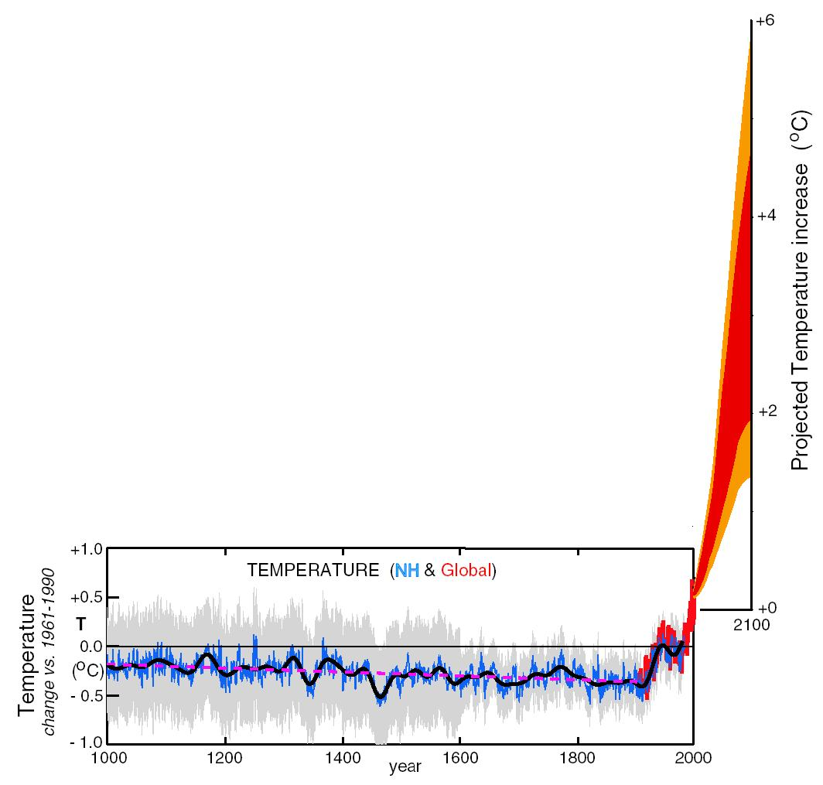
What can we expect in the future?
Don Wuebbles

Slide 21
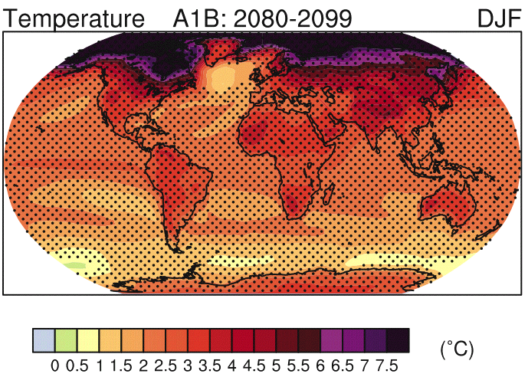
IPCC 2007

Slide 22
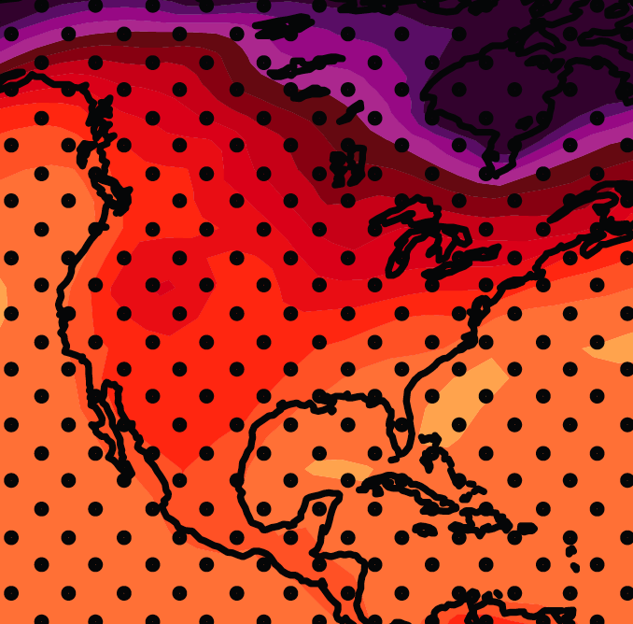
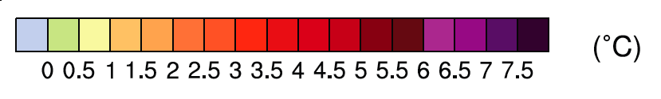
December-January-February Temperature Change
7.2ºF
6.3ºF
A1B Emission Scenario
2080-2099 minus1980-1999

Slide 23
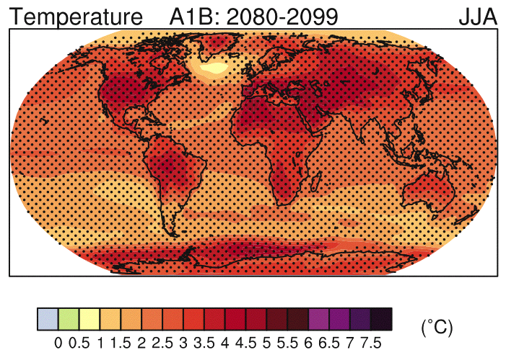
IPCC 2007

Slide 24
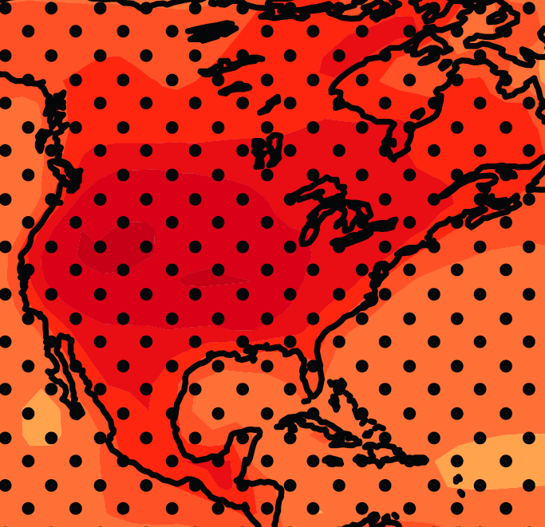
June-July-August Temperature Change
4.5ºF
5.4ºF
A1B Emission Scenario
2080-2099 minus1980-1999

Slide 25
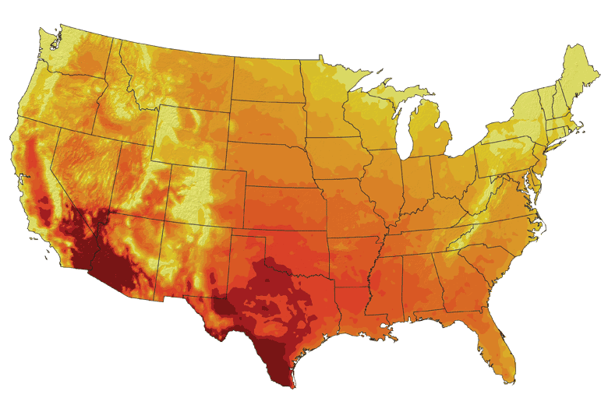
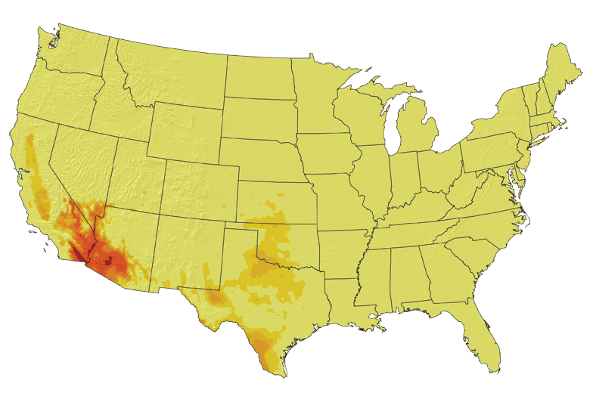
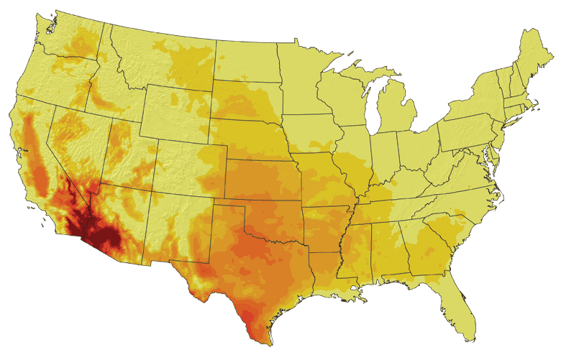
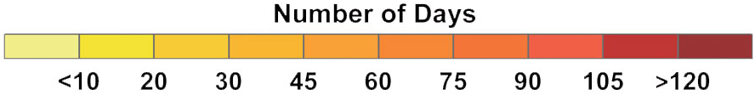
Increases in very high temperatures will have
wide-ranging effects
Higher Emissions Scenario, 2080-2099
Number of Days Over 100ºF
Recent Past, 1961-1979
Average:
30-60 days
Lower Emissions Scenario, 2080-2099
Average:
10-20 days
Don Wuebbles

Slide 26
Increases in very high temperatures will have
wide-ranging effects
Higher Emissions Scenario, 2080-2099
Number of Days Over 100ºF
Recent Past, 1961-1979
Average:
30-60 days
Current Des Moines average is < 1.4 days per year over 100ºF
Lower Emissions Scenario, 2080-2099
Average:
10-20 days
Don Wuebbles

Slide 27
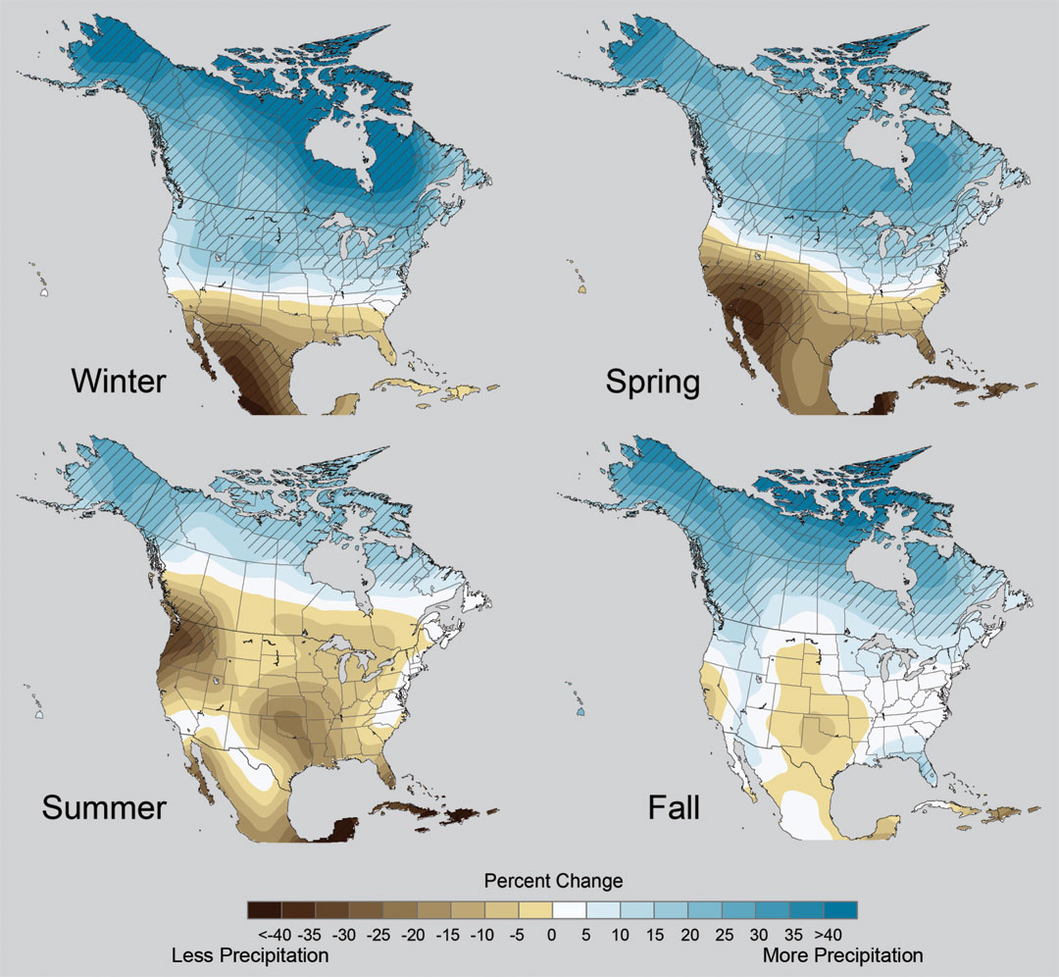
Projected Change in Precipitation: 2081-2099
Midwest: Increasing winter and spring precipitation, with drier summers
More frequent and intense periods of heavy rainfall
Unstippled regions indicate reduced confidence
Relative to 1960-1990
NOTE: Scale Reversed
Don Wuebbles

Slide 28
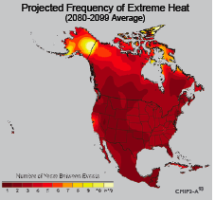
Extreme weather events become more common
Events now considered rare will become commonplace.
Heat waves will likely become longer and more severe
Droughts are likely to become more frequent and severe in some regions
Likely increase in severe thunderstorms (and perhaps in tornadoes).
Winter storm tracks are shifting
northward and the strongest storms are
likely to become stronger and more
frequent.
Don Wuebbles
Notes:
Shown here is the frequency at the end of the century of what we consider now to be a 20 year heat wave. Instead of once every 20 years, these temperatures would be experienced every other year or so over most of the continental US in this business as usual scenario.

Slide 29
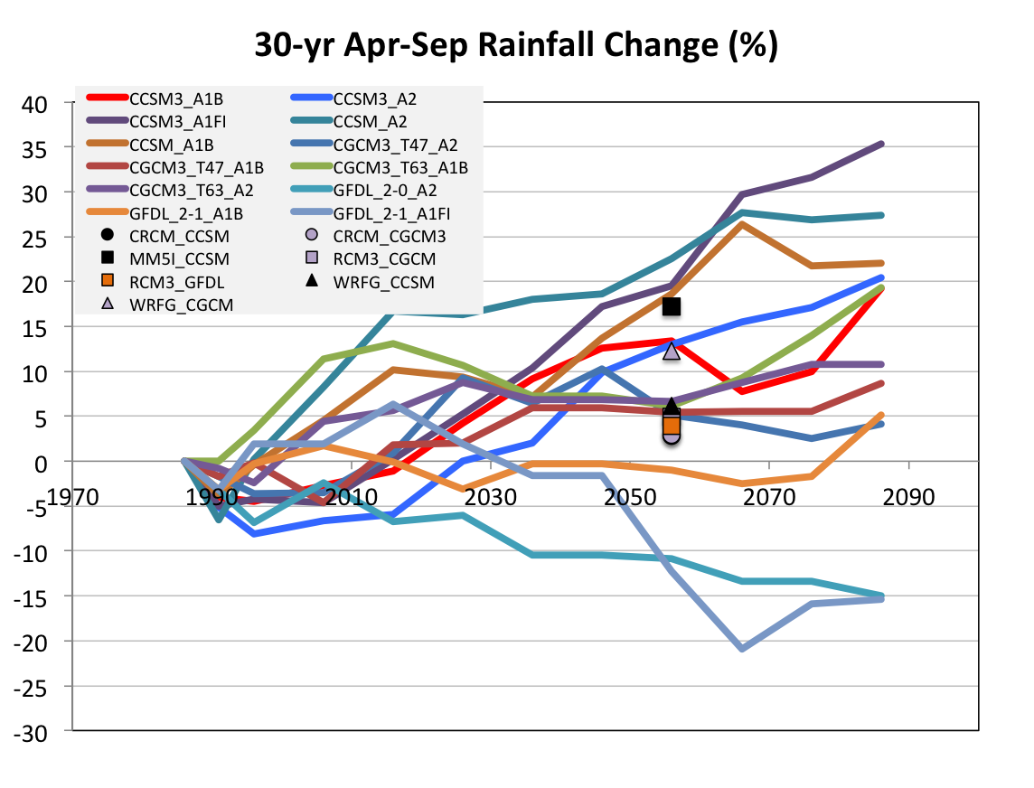
Change in Growing Season Precipitation for Iowa
No change
CJ Anderson, ISU

Slide 30
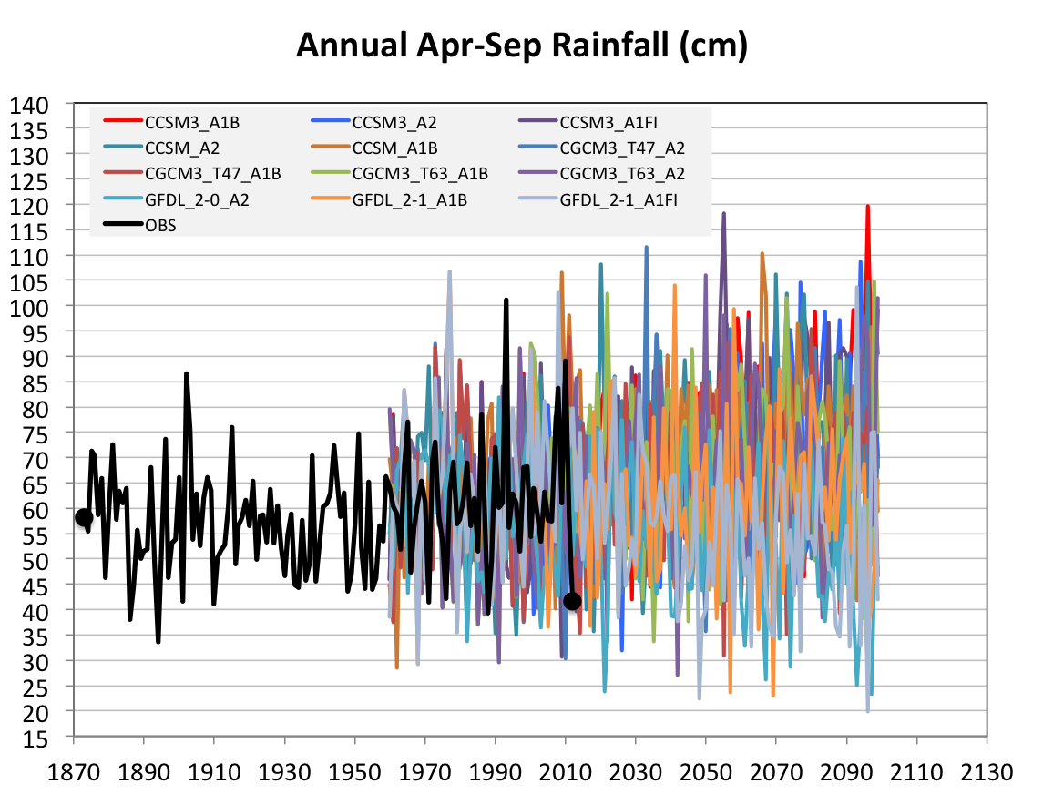
Future Variability in Growing Season Precipitation for Iowa
More extreme floods
More extreme droughts
CJ Anderson, ISU

Slide 31
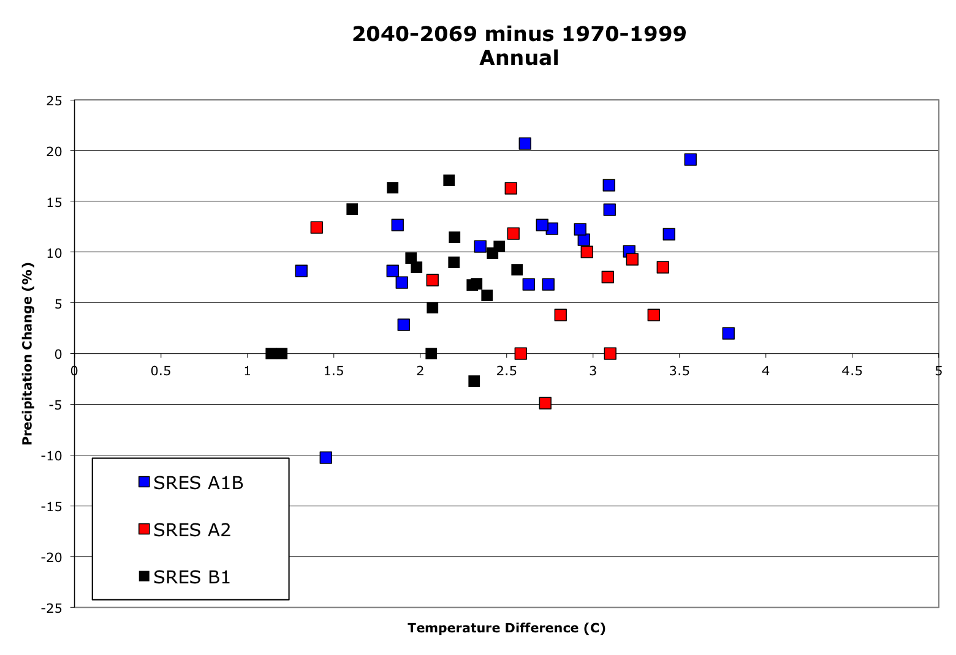
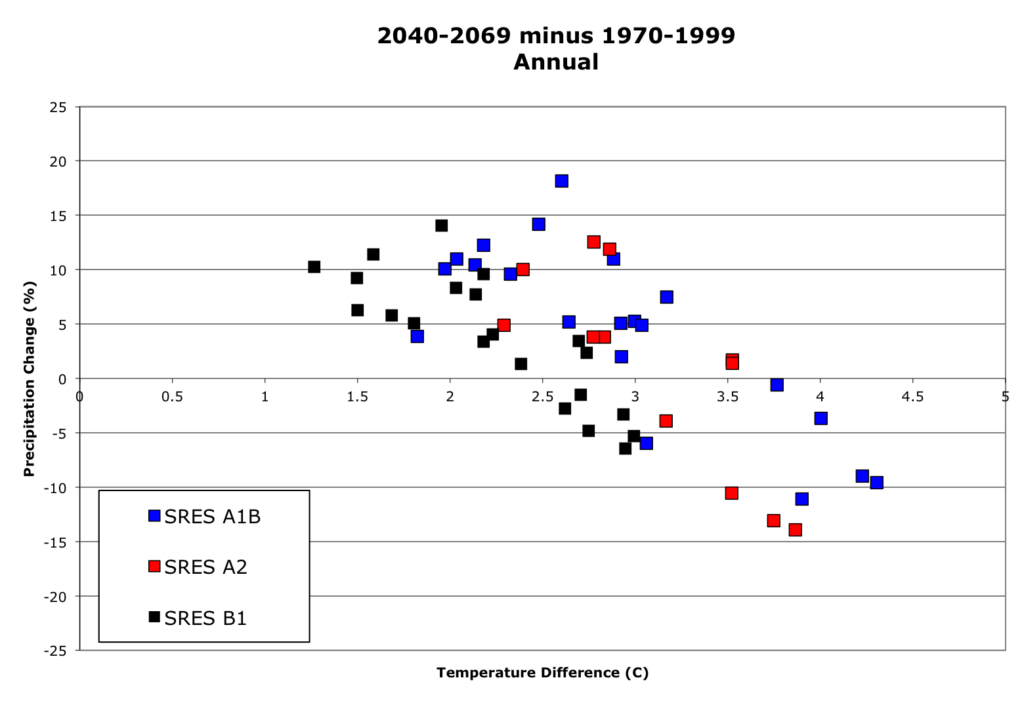
Projected Changes in Mean Precipitation in the US Midwest
US global climate models
(higher flood potential)
Precipitation Change (%)
Zero change
Temperature Change (ºC)
Non-US global climate models
(higher drought potential)
CJ Anderson, ISU

Slide 32
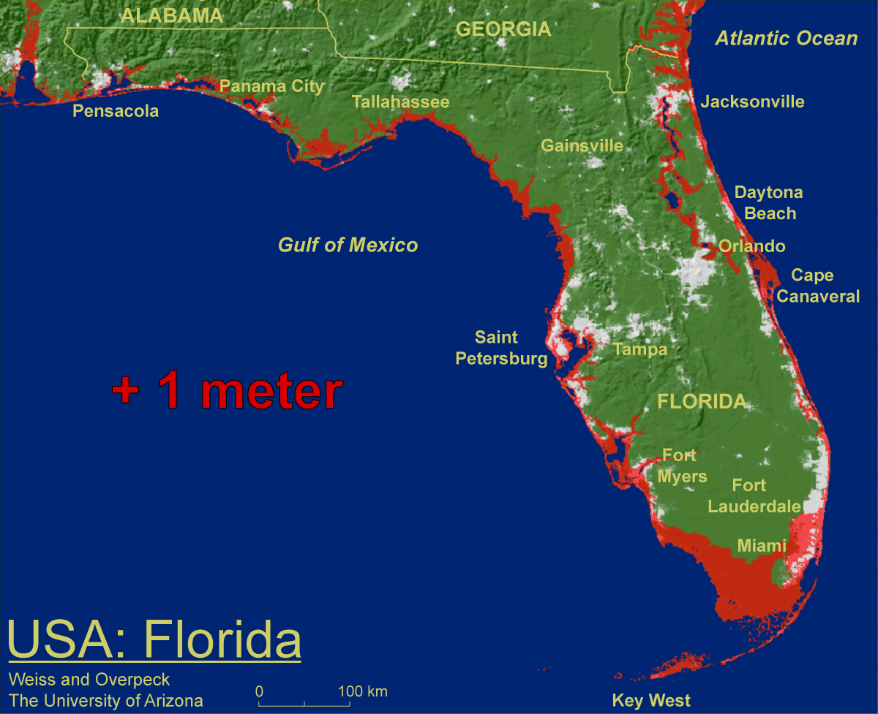
1 meter will be hard to avoid, possibly within this century, just from thermal expansion and small glacier melt.
Don Wuebbles

Slide 33

Widespread climate-related impacts are occurring now and are expected to increase
Water Resources
Energy Supply & Use
Transportation
Agriculture
Don Wuebbles
Ecosystems
Human Health
Society

Slide 34
First Date Iowa’s Average Fall 4-inch Soil Temperature Was Below 50ºF
Iowa Environmental Mesonet 2010

Slide 35
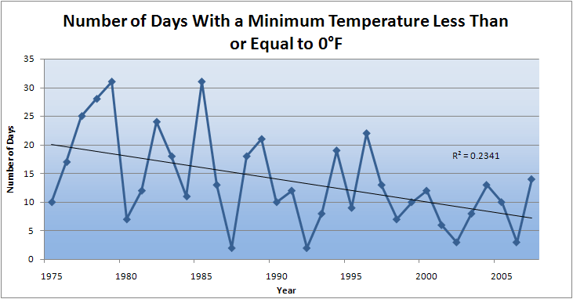
Des Moines Airport Data
Caution: Not corrected for urban heat island effects

Slide 36
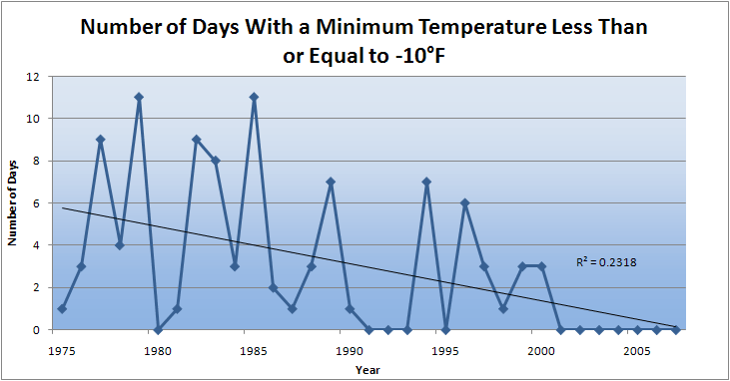
Des Moines Airport Data
Caution: Not corrected for urban heat island effects

Slide 37
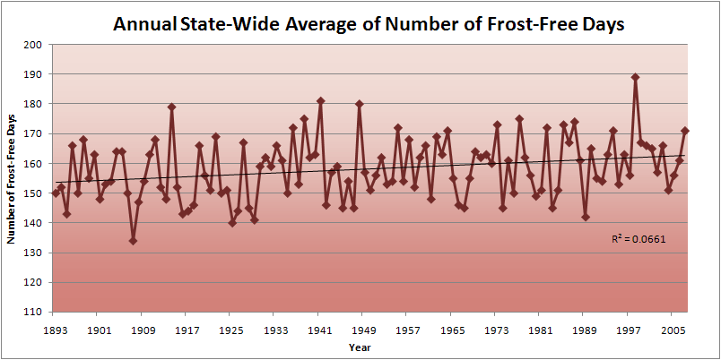
Iowa State-Wide Average Data

Slide 38
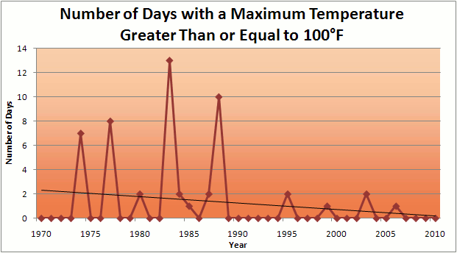
Des Moines Airport Data
1983: 13
8 days in 2012
1988: 10
1977: 8
6 days ≥ 100ºF in the last 22 years

Slide 39
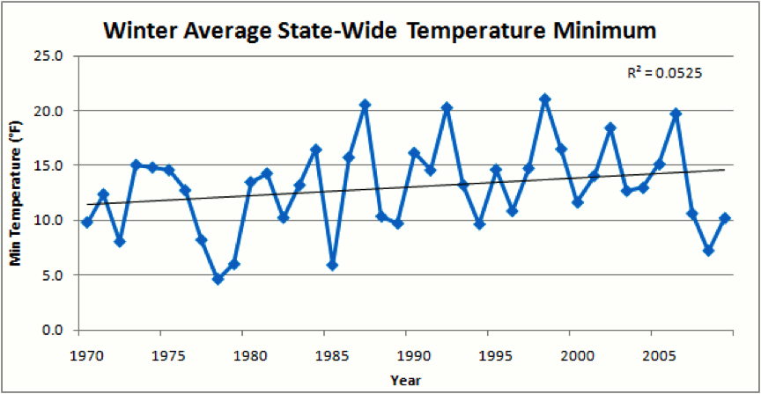
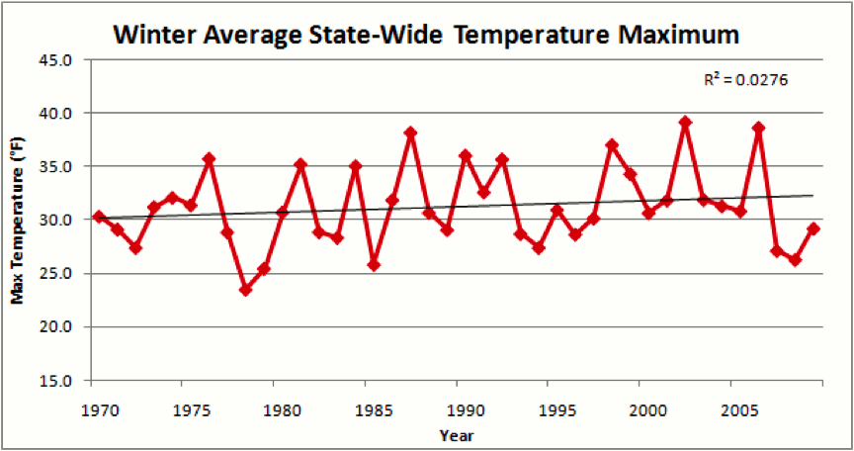
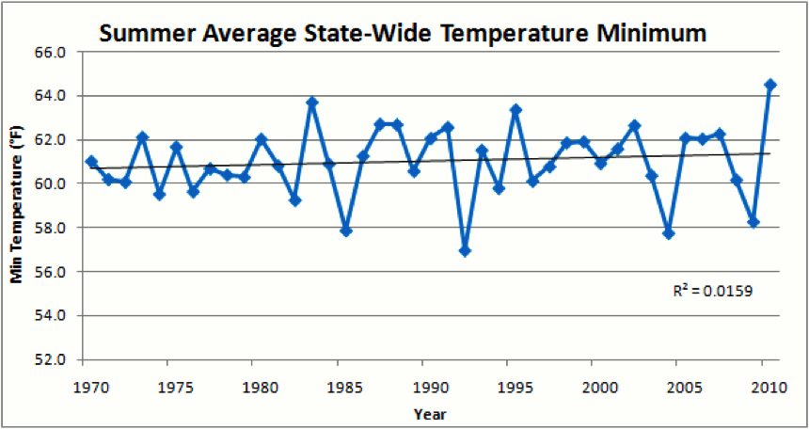
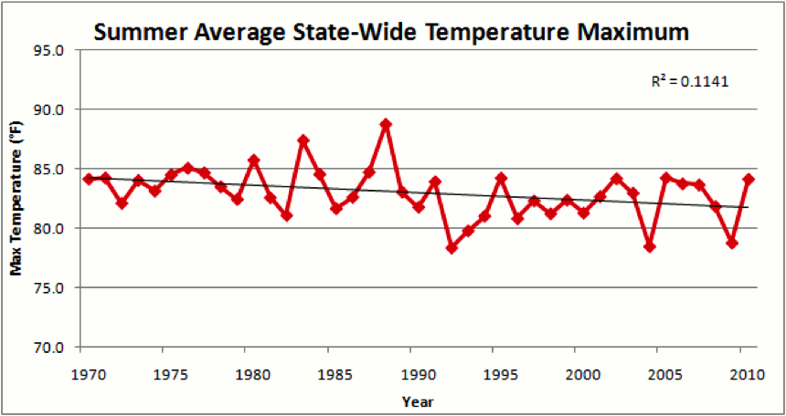

Slide 41
Summer (JJA) Cloud Cover, Des Moines

Slide 42
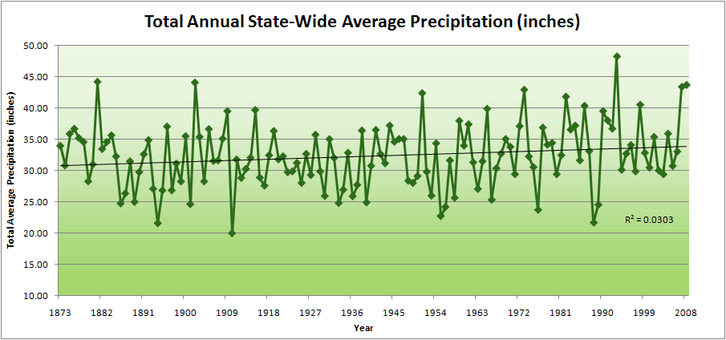
Iowa State-Wide Average Data

Slide 43
Iowa State-Wide Average Data
34.0”
10% increase
30.8”

Slide 44
Iowa State-Wide Average Data
Totals above 40”
2 years

Slide 45
Iowa State-Wide Average Data
Totals above 40”
8 years
2 years

Slide 46
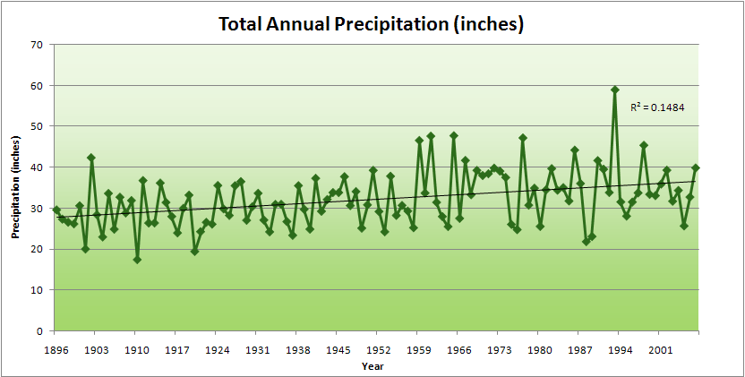
Cedar Rapids Data

Slide 47
Cedar Rapids Data
28.0”
32% increase
37.0”

Slide 48
Cedar Rapids Data
Years with more than 40 inches
1
28.0”
32% increase
37.0”

Slide 49
Cedar Rapids Data
Years with more than 40 inches
11
1
28.0”
32% increase
37.0”

Slide 50
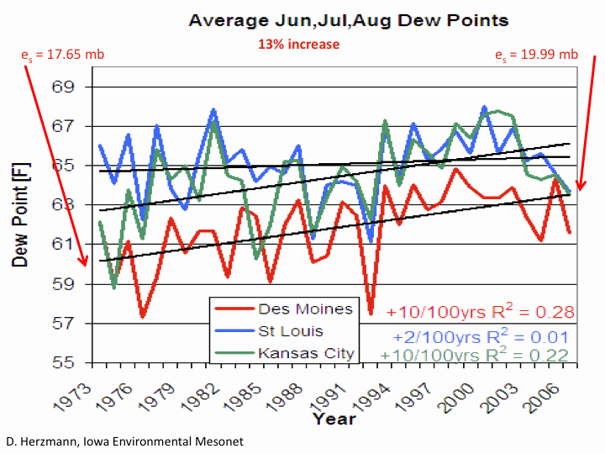

Slide 51
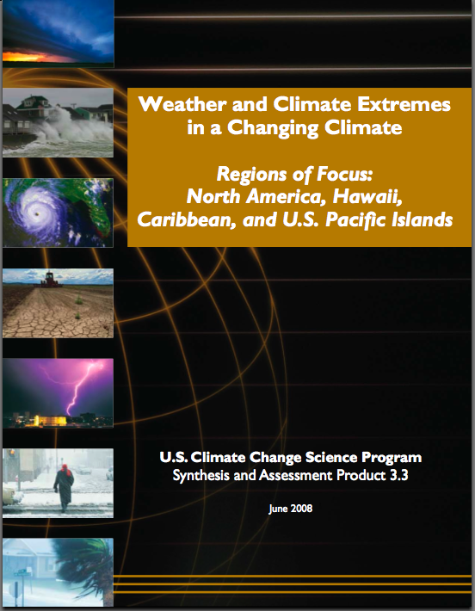
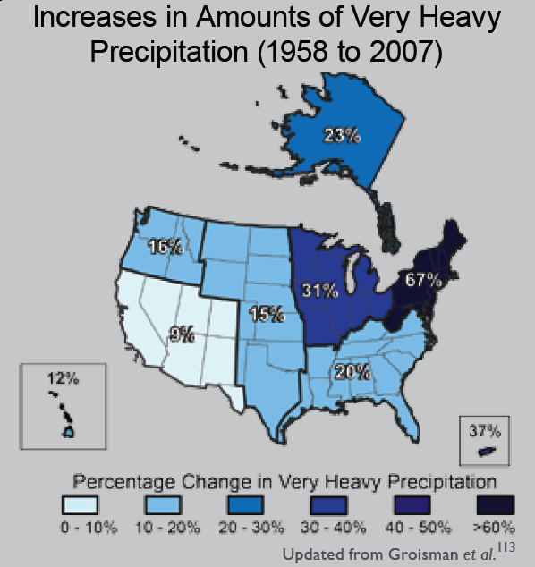
“One of the clearest trends in the United States observational record is an increasing frequency and intensity of heavy precipitation events… Over the last century there was a 50% increase in the frequency of days with precipitation over 101.6 mm (four inches) in the upper midwestern U.S.; this trend is statistically significant “
Karl, T. R., J. M. Melillo, and T. C. Peterson, (eds.), 2009: Global Climate Change Impacts in the United States. Cambridge University Press, 2009, 196pp.

Slide 52

Cedar Rapids Data
1.25 inches
4.2 days
57% increase
6.6 days

Slide 53
Cedar Rapids Data
1.25 inches
Years having more than 8 days
13
2
4.2 days
57% increase
6.6 days

Slide 54




Amplification of the Seasonality of Precipitation
Spring
Fall
Summer
Winter

Slide 55
Amplification of the Seasonality of Precipitation
Spring
Fall
Summer
Winter

Slide 56
Amplification of the Seasonality of Precipitation
Spring
Fall
Summer
Winter

Slide 57
Amplification of the Seasonality of Precipitation
Spring
Fall
Summer
Winter

Slide 58
Amplification of the Seasonality of Precipitation
Spring
Fall
Summer
Winter

Slide 59
Amplification of the Seasonality of Precipitation
Spring
Fall
Summer
Winter

Slide 60
Amplification of the Seasonality of Precipitation
Spring
Fall
Summer
Winter

Slide 61
Amplification of the Seasonality of Precipitation
Spring
Fall
21.2 => 25.3 inches (22% increase)
12.1 => 10.5 inches (13% decrease)
Summer
Winter

Slide 62
Iowa Agricultural Producers’ Adaptations to Climate Change
Longer growing season: plant earlier, plant longer season hybrids, harvest later
Wetter springs: larger machinery enables planting in smaller weather windows
More summer precipitation: higher planting densities for higher yields
Wetter springs and summers: more subsurface drainage tile is being installed, closer spacing, sloped surfaces
Fewer extreme heat events: higher planting densities, fewer pollination failures
Higher humidity: more spraying for pathogens favored by moist conditions. more problems with fall crop dry-down, wider bean heads for faster harvest due to shorter harvest period during the daytime.
Drier autumns: delay harvest to take advantage of natural dry-down conditions
HIGHER YIELDS!!
Is it genetics or climate? Likely some of each.

Slide 63
Why Small Changes in Rainfall Produce Much More Flooding
13% increase in atmospheric moisture in June-July-August
~10% increase in average precipitation in Iowa
~5-fold increase in high-precipitation events, mostly in June-July-August, that lead to runoff
Iowa rivers and watersheds are oriented NW-SE
Rainfall patterns turn from SW-NE in March-May to W-E or NW-SE in mid summer
More frequent floods are the result of one or more of the following
    More rain
    More intense rain events
    More rain in the summer
    Rainfall patterns more likely to align with streams and watersheds
    Streams amplify changes in precipitation by a factor of 2-4
AND: more subsurface drainage tile has been installed

Slide 64
Climate trends of the recent past have low statistical significance. Nevertheless, they have forced significant agricultural and societal adaptation:

Slide 65
Climate trends of the recent past have low statistical significance. Nevertheless, they have forced significant agricultural and societal adaptation:
Even climate trends of low statistical significance can have impacts of high agricultural and societal significance

Slide 66

Rise in global mean temperature (ºC)

Slide 67

Rise in global mean temperature (ºC)

Slide 68

Energy intensive
Balanced fuel sources
More environmentally friendly
Limit to avoid “dangerous anthropogenic
Interference” with the climate system
2ºC limit
IPCC Fourth Assessment Report Summary for Policy Makers

Slide 69

Long-Term Stabilization Profiles
A2
B1
Nebojša Nakićenović IIASA, Vienna

Slide 70
Long-Term Stabilization Profiles
A2
Achieving this emission reduction scenario will provide a 50% chance of not exceeding the 2ºC guardrail
B1
Nebojša Nakićenović IIASA, Vienna

Slide 71
“Big Fixes” for Climate
UCAR Quarterly , Fall 2006
Sprinkle iron dust in the polar oceans
Inject large amounts of sulfate aerosol into the stratosphere
Launch saltwater spray to modify marine stratus clouds
Position 16,000,000,000,000 transparent, sunlight-refracting shades that would be deployed at the inner Lagrangian point of gravitational balance, about 1.5 million km from Earth toward the Sun. 20 launchers would each need to loft 800,000 screens every five minutes for ten years.

Slide 72

Illustration courtesy John MacNeill

Slide 73

Big Fixes for Climate
UCAR Quarterly
Fall 2006
A few of the 16 trillion sunlight-refracting shades proposed for deployment. Each mirror would span less than a square meter. The use of refraction rather than reflection would diminish sunlight-induced pressure from that would otherwise shift the shades' orbit. (Image courtesy of Roger Angel, UA Steward Observatory.)

Slide 74
Summary
Global temperature trends of the 20C cannot be explained on the basis of natural variation alone
Only when the influences of greenhouse gases and sulfate aerosols are included can the trends be explained
Models that explain these trends, when projected into the future, indicate a 1.5-6.5ºC warming over the 21C
Substantial adverse consequences to sea-level rise, food production, fresh-water supplies, severe weather events, and human health will occur for temperature increases above 2ºC
“Big Fixes” have big negative side effects

Slide 75
For More Information
Contact me directly:
gstakle@iastate.edu
Current research on regional climate and climate change is being conducted at Iowa State University under the Regional Climate Modeling Laboratory
http://rcmlab.agron.iastate.edu/
North American Regional Climate Change Assessment Program
http://www.narccap.ucar.edu/
For current activities on the ISU campus, regionally and nationally relating to climate change see the Climate Science Initiative website:
http://climate.engineering.iastate.edu/
Or just Google Eugene Takle

Slide 76

Carbon Dioxide
and Temperature
2012
390 ppm

